Slide 1
STOR 455 Bootstrap and Simple Linear Model Fitting
Read: 4.7

Slide 2
Midterm 1
February 28. Class time.
15% of course grade. No make-up.
Instructions for Midterm 1 posted on Sakai.
Covers every lecture up to today and all HWs.
Class on Feb. 23 as a review of materials.

Slide 3
Assessing Variability without a Model
After estimating the slope in regression, we can construct inference if the 5 conditions of linear models hold.
What if the conditions are violated?
Nonparametric methods can help here.
Bootstrap is an important way to evaluate the variability without strong model assumptions.

Slide 4

Matryoshka Dolls Analogy of Bootstrap Inference
Population -> Sample -> Bootstrap resample
Variability in sampling should be similar to that in bootstrap resampling.

Slide 5



Sampling Distribution
Population
BUT, in practice we don’t see the “tree” or all of the “seeds” – we only have ONE seed
$${\hat{β}}_{i}$$
$$β_{i}$$

Slide 6

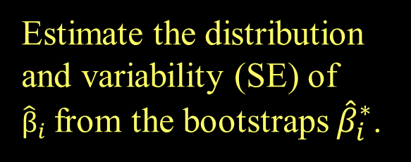

Bootstrap Distribution
Estimate the distribution and variability (SE) of ${\hat{β}}_{i}$from the bootstraps ${\hat{β}}_{i}^{∗}$.
What can we do with just one seed?
Bootstrap
“Population”
Grow a NEW tree!
$${\hat{β}}_{i}$$
$${\hat{β}}_{i}^{∗}$$

Slide 7
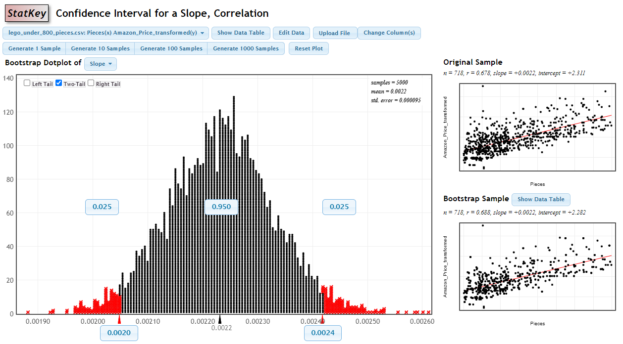
Bootstrap Distribution
Illustration with lego_under_800_pieces.csv in Lecture 8.

Slide 8
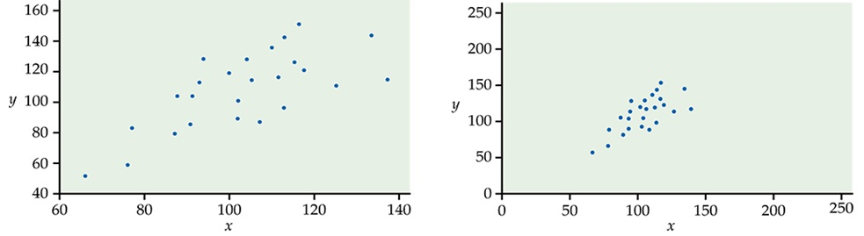
Which Association Is Stronger?

Slide 9
Correlation
The correlation between two quantitative variables is a number between -1 and 1, denoted by r, that tells us the direction and strength of the linear (straight-line) association between them.
The sign of correlation indicates the direction of the linear association.
r is between -1 and 1.
A value of r near -1 or 1 indicates a strong linear association (points lie close to a straight line).
A value of r near 0 indicates a weak linear association, or no association, but may also arise from a nonlinear association.
Pros: r will not change if we:
exchange explanatory and response variables.
express the values using different units (invariant for linear transformation).
Cons: Correlation is not resistant to outliers.

Slide 10
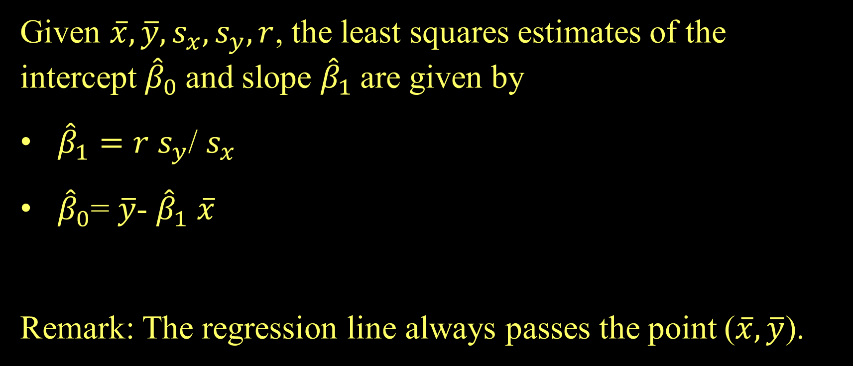
Fitting a Simple Linear Model
Given $\overline{x}, \overline{y}, s_{x}, s_{y}, r$, the least squares estimates of the intercept ${\hat{β}}_{0}$and slope ${\hat{β}}_{1}$are given by
${\hat{β}}_{1}=r s_{y}$/ $s_{x}$
${\hat{β}}_{0}$= $\overline{y}$- ${\hat{β}}_{1}$ $\overline{x}$
Remark: The regression line always passes the point ($\overline{x}, \overline{y}$).

Slide 11
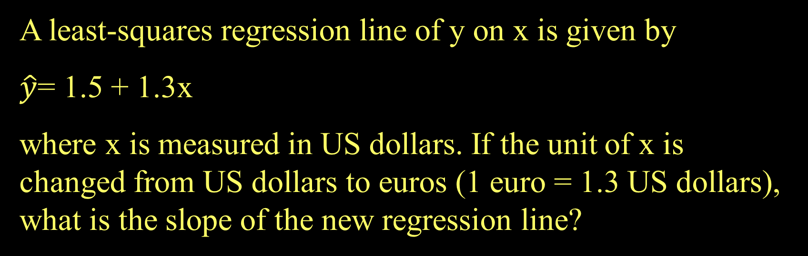
Example Question
A least-squares regression line of y on x is given by
$\hat{y}$= 1.5 + 1.3x
where x is measured in US dollars. If the unit of x is changed from US dollars to euros (1 euro = 1.3 US dollars), what is the slope of the new regression line?

